Slide 1
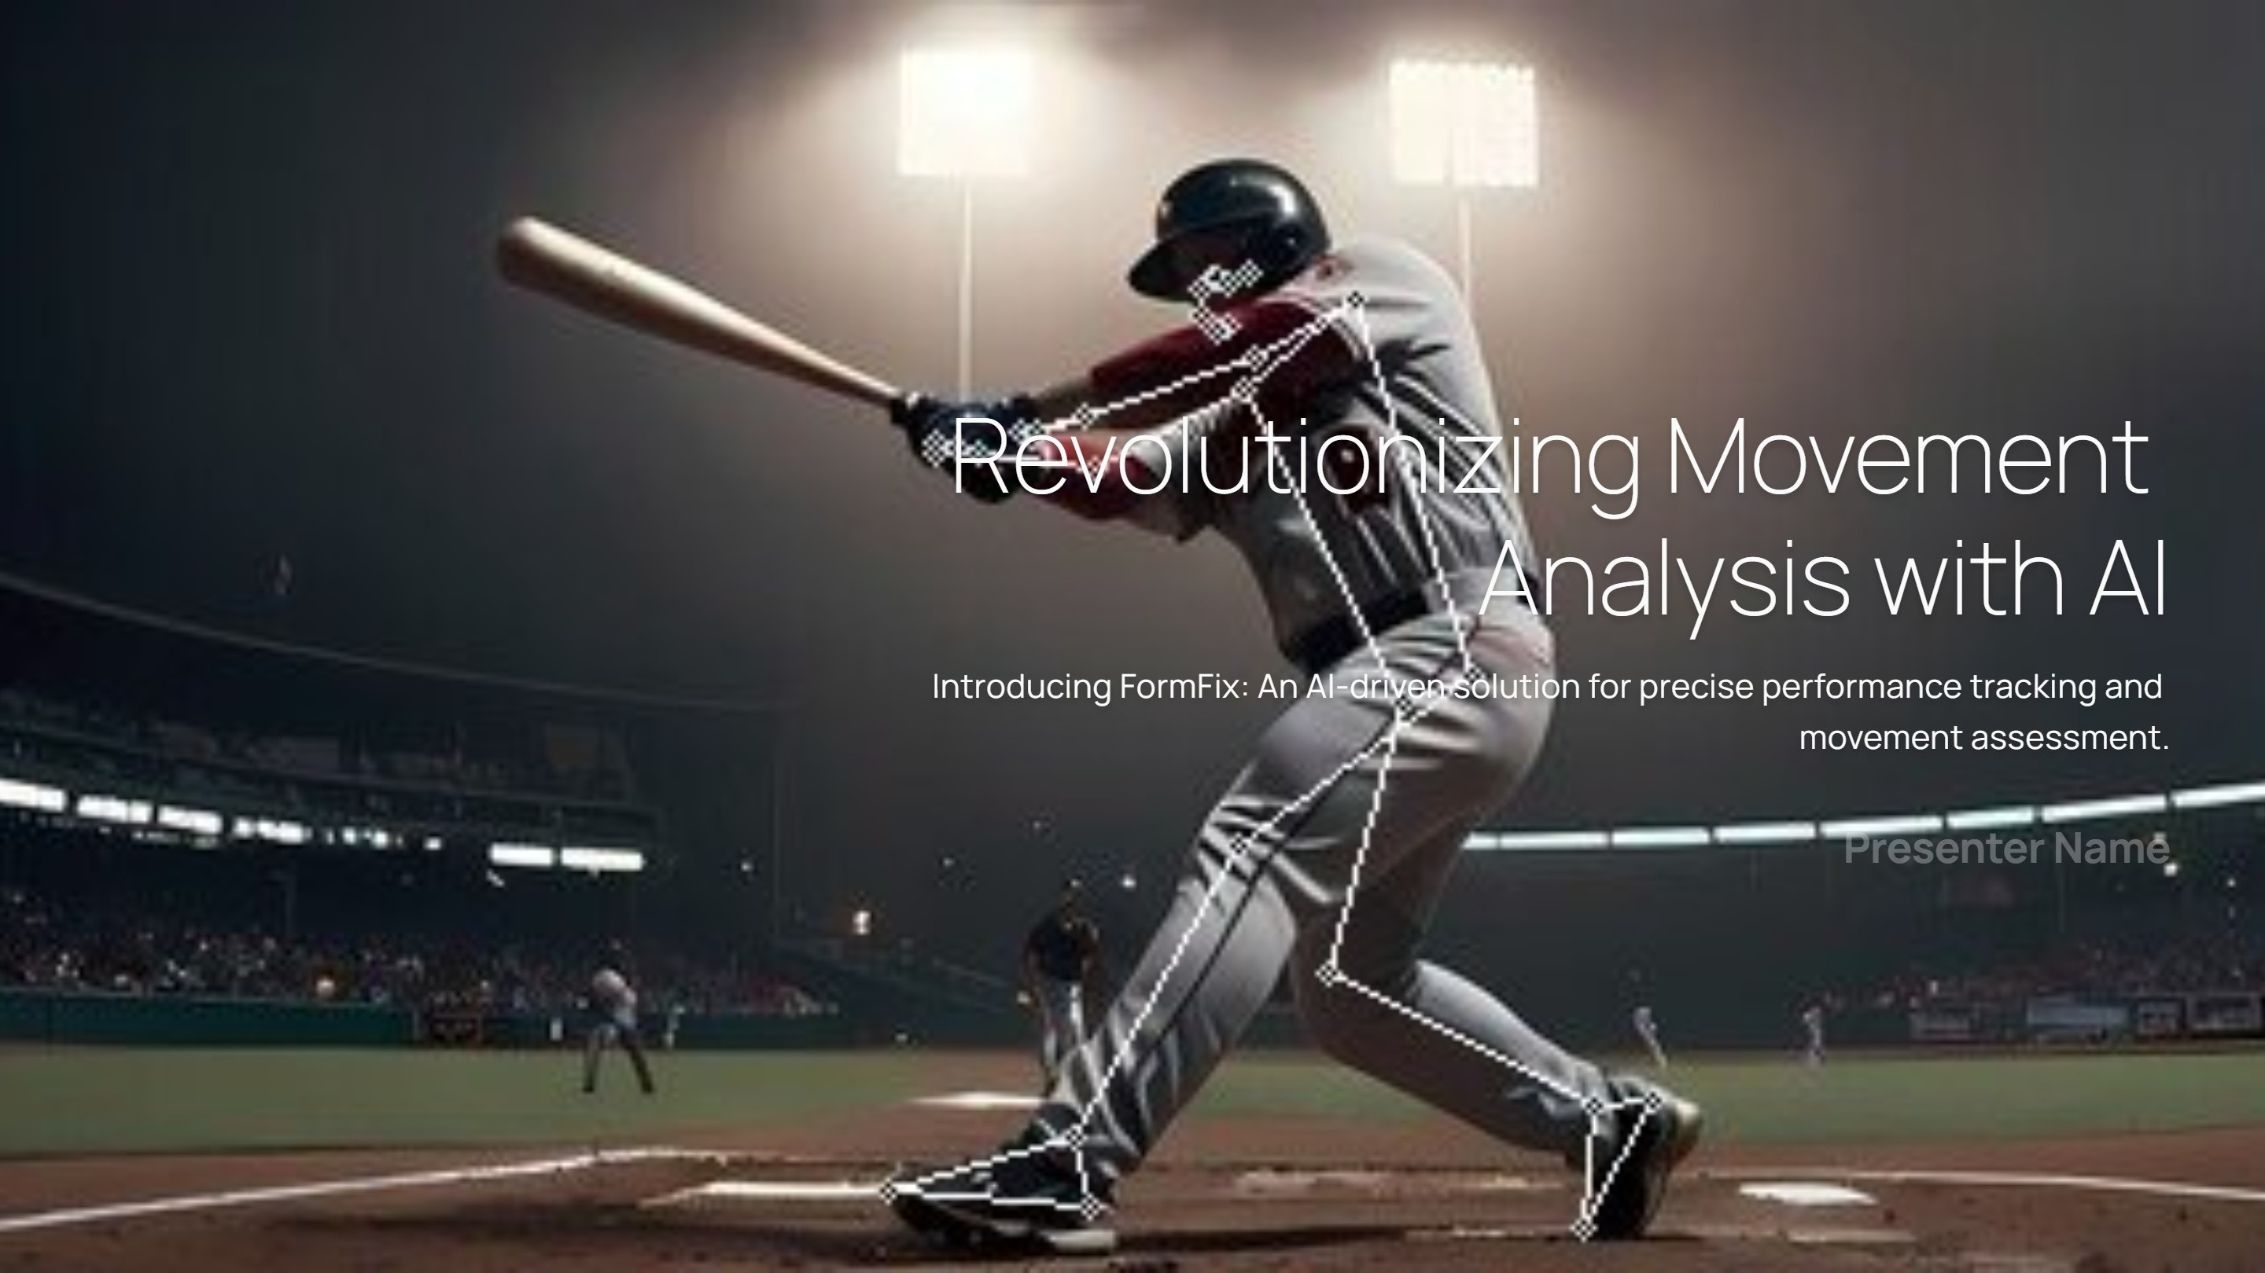

T.Srinivas(221210111)
V.Akhil naik(221210115)
Y.siva(221210125)

Slide 2
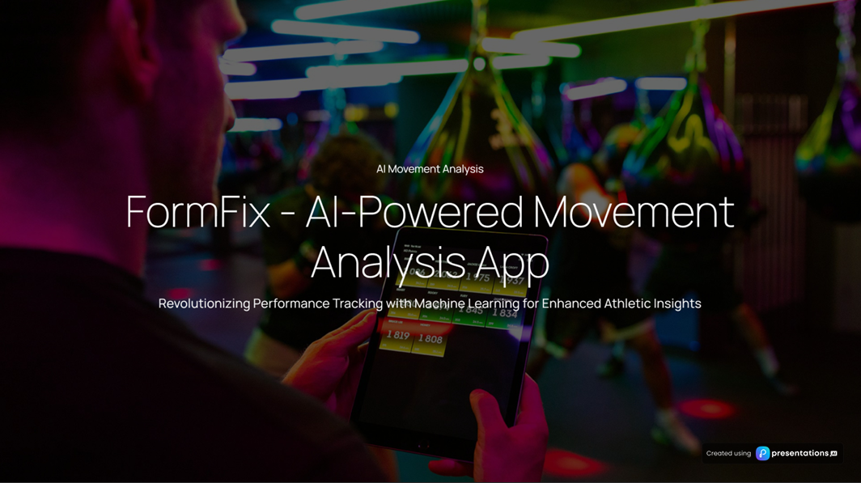

Slide 3
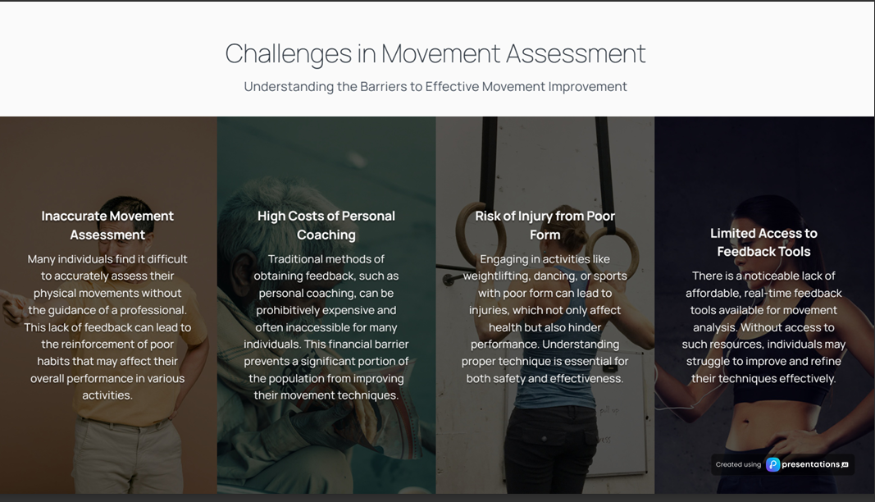

Slide 4
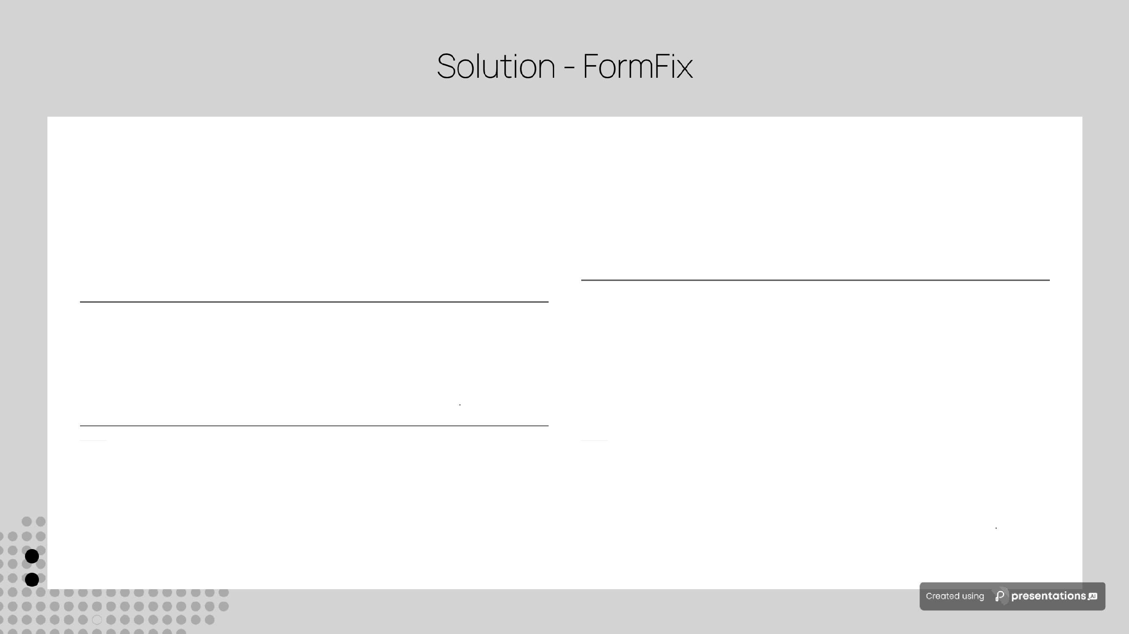
Al-Powered Video Analysis
FormFix is an innovative application that leverages artificial intelligence to analyze videos uploaded by users, providing a detailed comparison with professional reference videos to enhance performance.
04 Efficient and Affordable Refinement
Designed for accessibility, FormFix enables users to refine tneir form efficiently and affordably, making professional coaching insights available to everyone.
01
Accuracy Scores and Visual Feedback
The app not only assesses the user's form but also delivers precise accuracy scores along with visual feedback, helping users understand their performance metrics clearly
02
05 Bridging Professional Coaching and Self-Assessment
FormFix serves as a bridge between traditional professional coaching and self-assessment, allowing users to take charge of their training while benefiting from advanced technology
03
Improvement Suggestions
FormFix goes beyond feedback by offering tailored improvement suggestions, empowering users to make effective adjustments to their form.

Slide 5
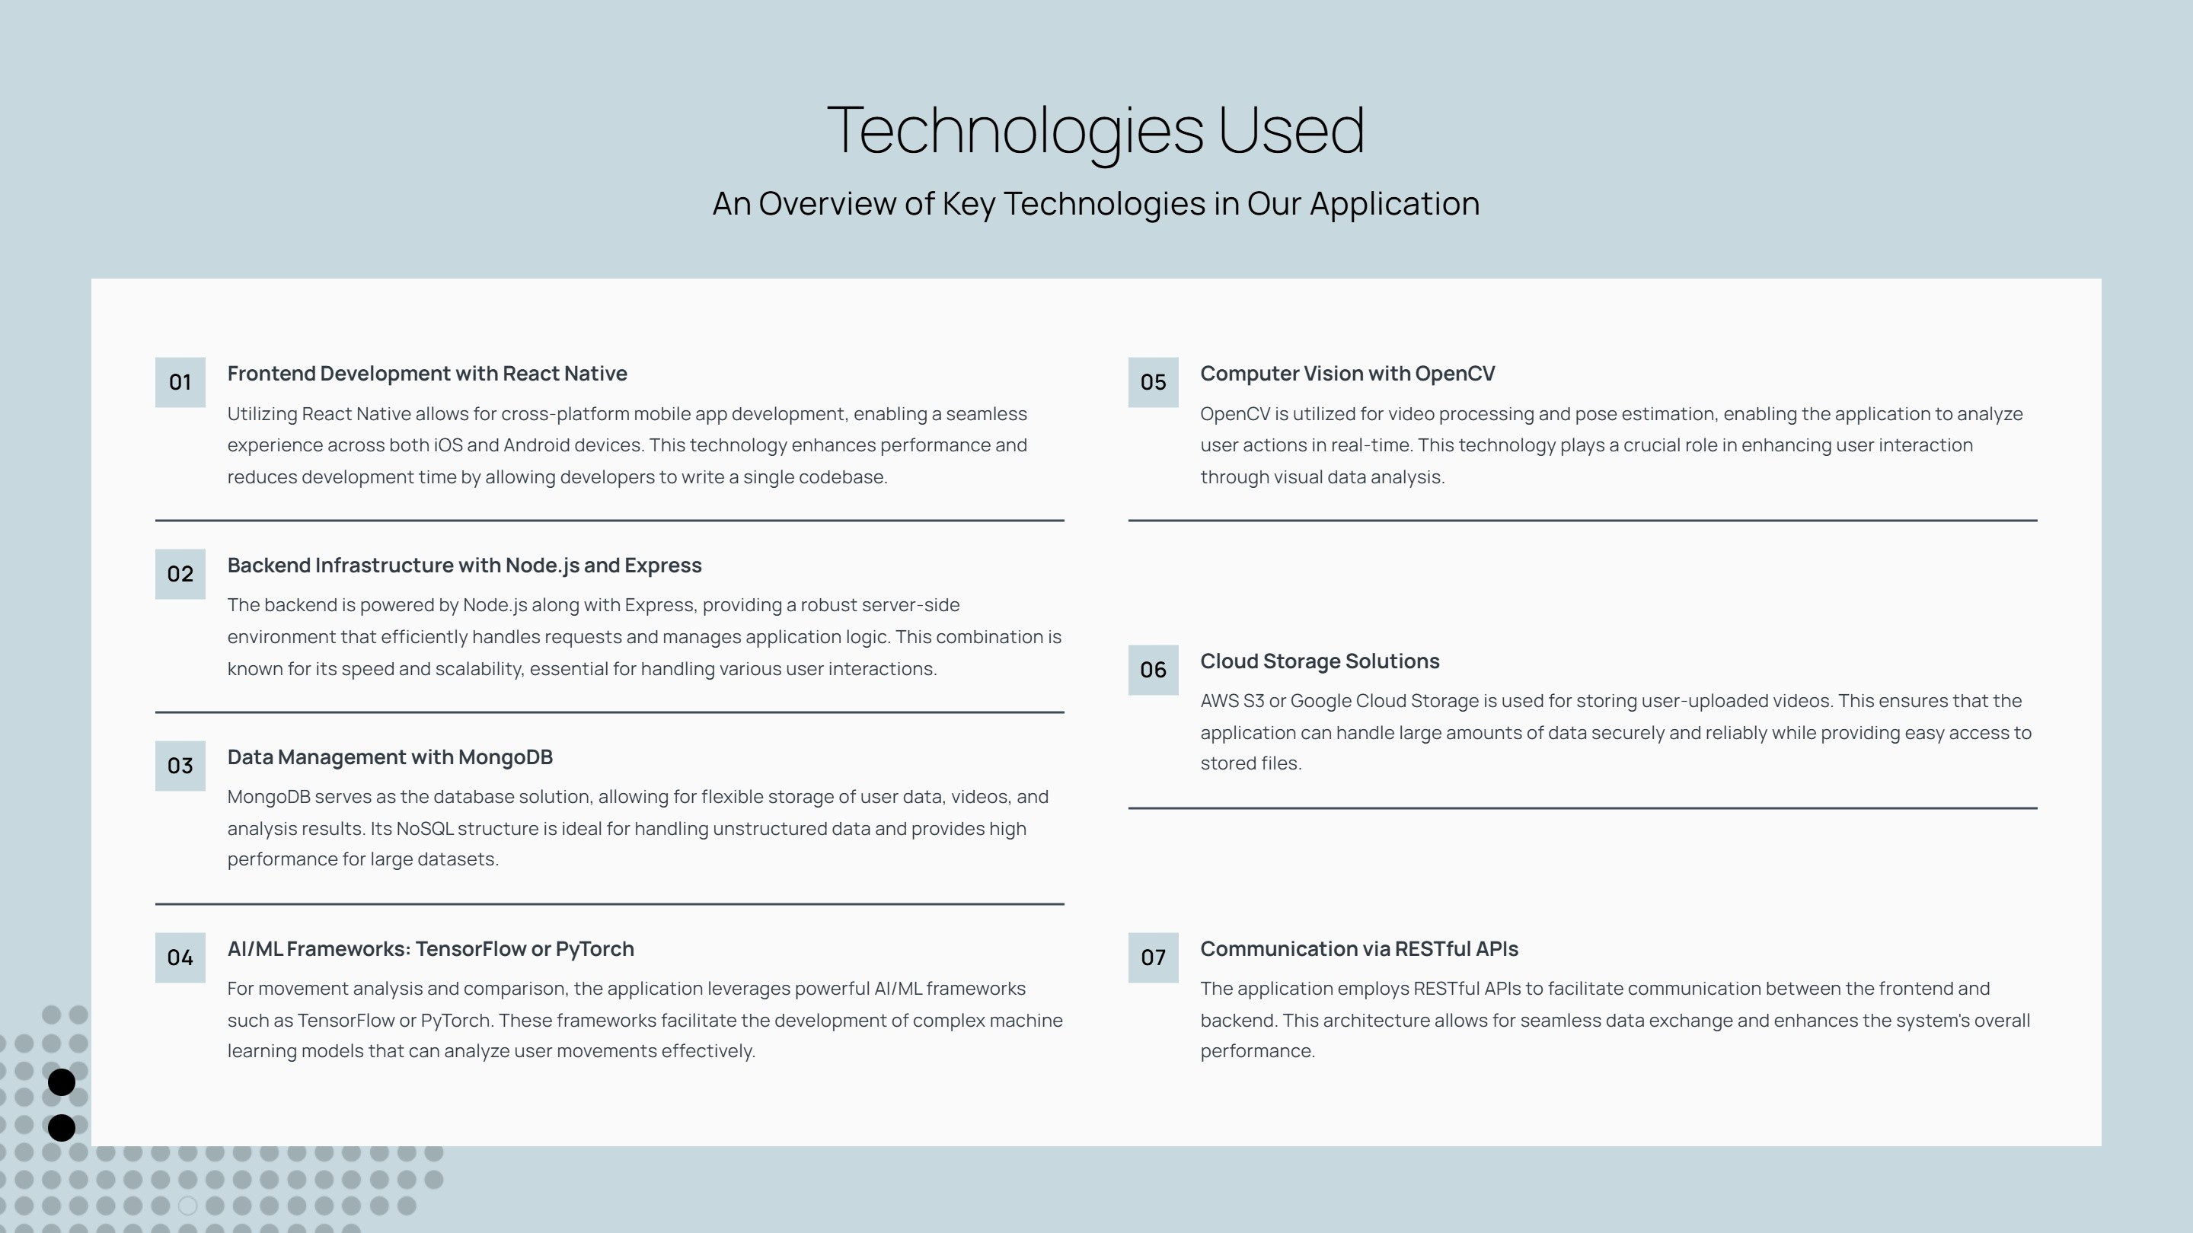

Slide 6
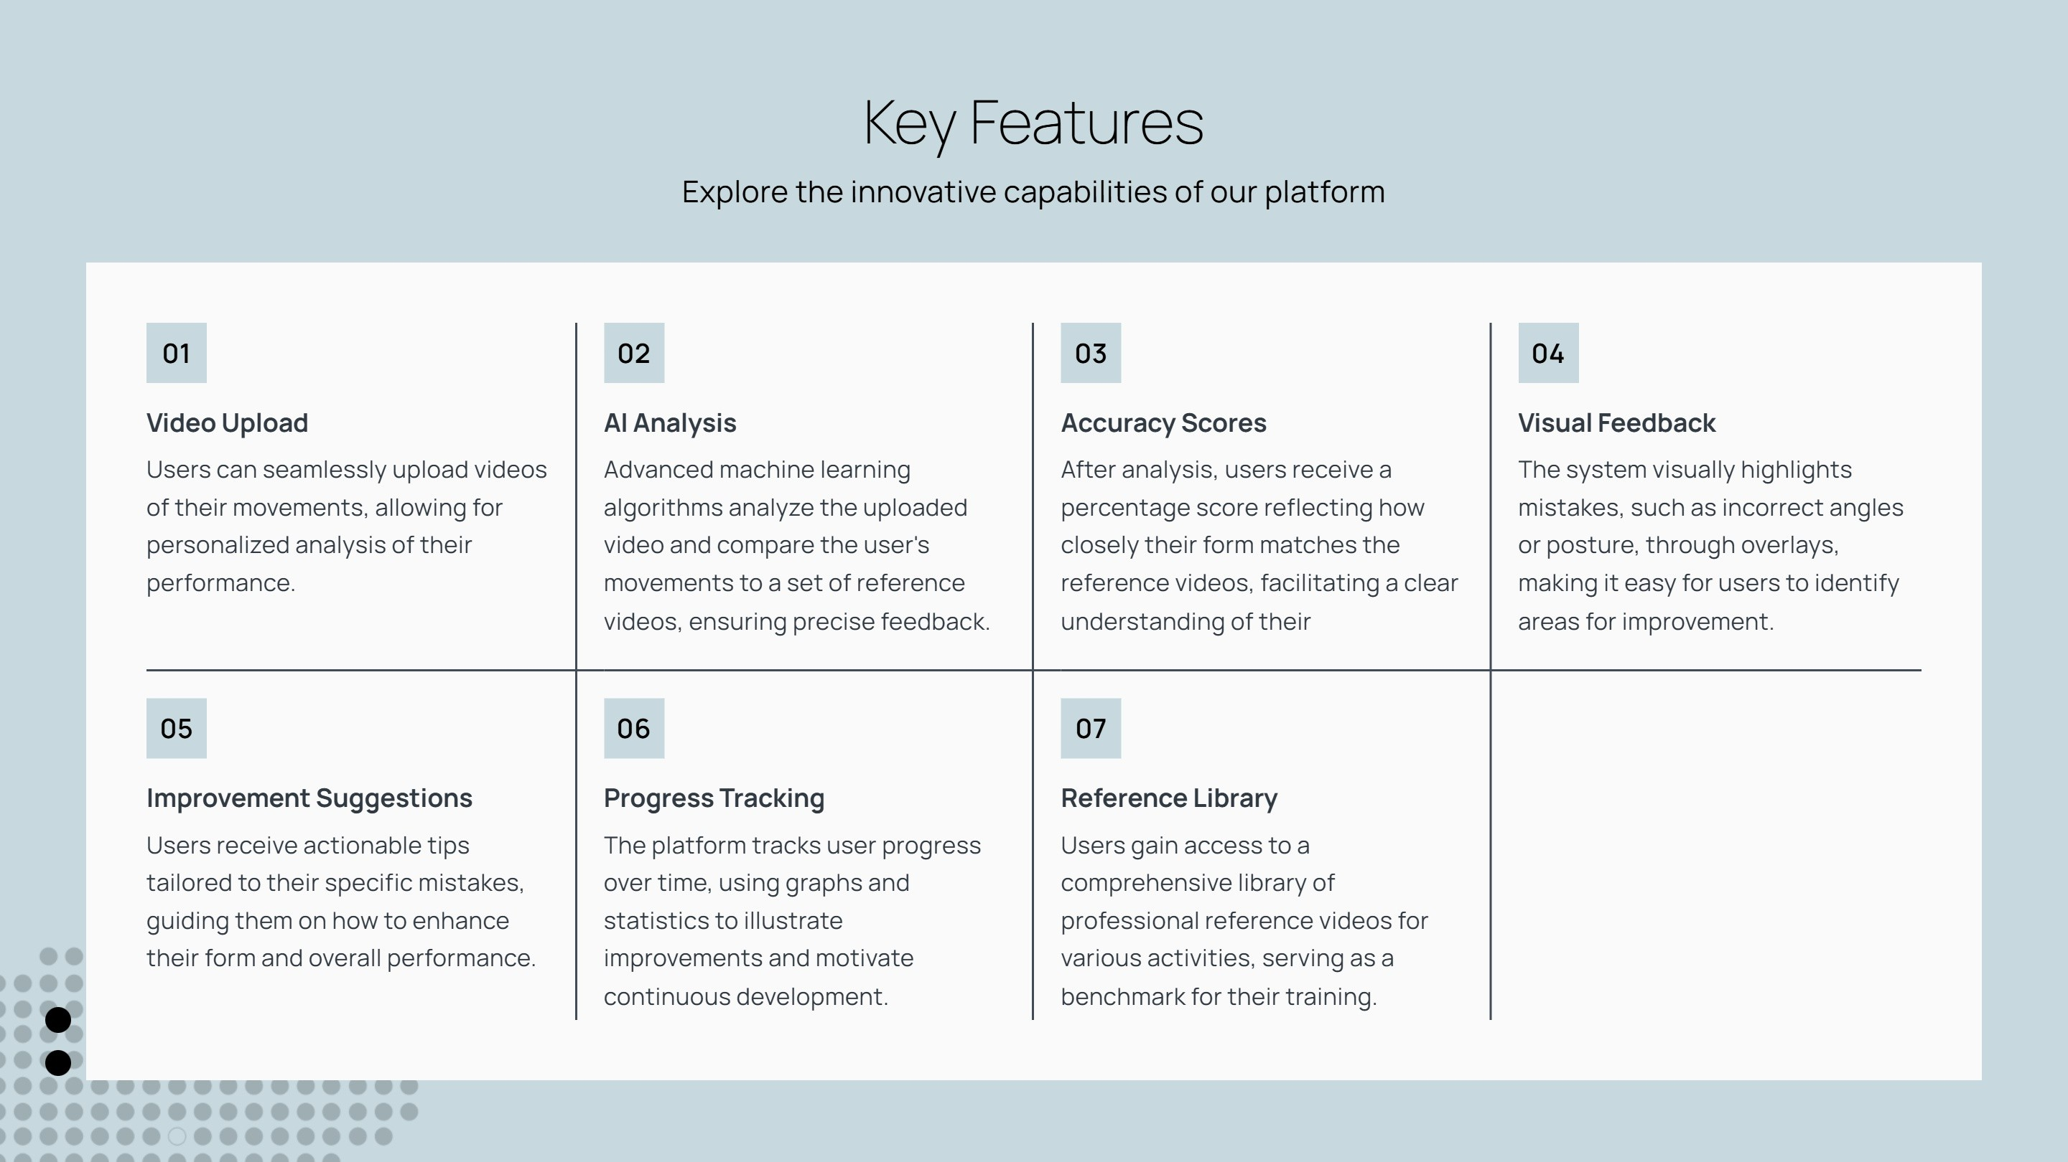

Slide 7
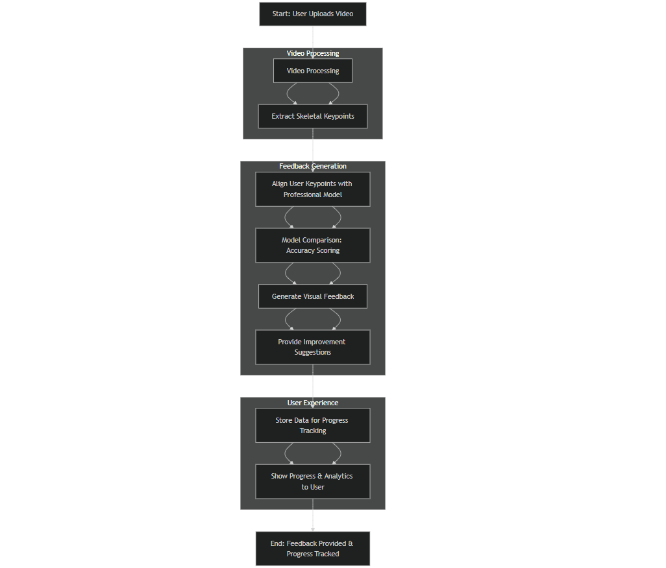
DATA FLOW DIAGRAM (DFD)

Slide 8
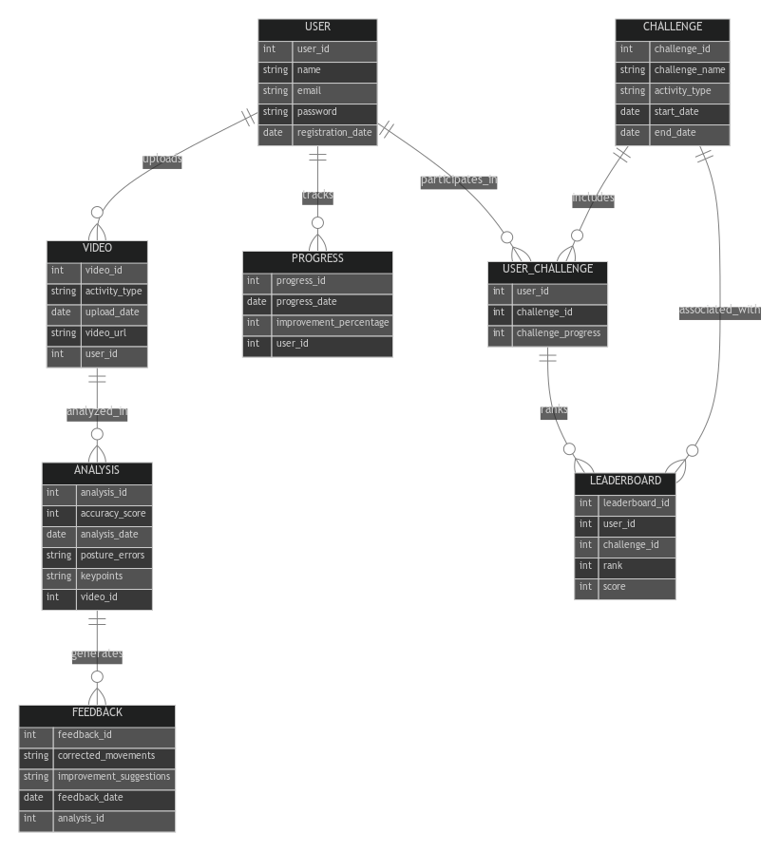
Entity-Relationship Diagram

Slide 9
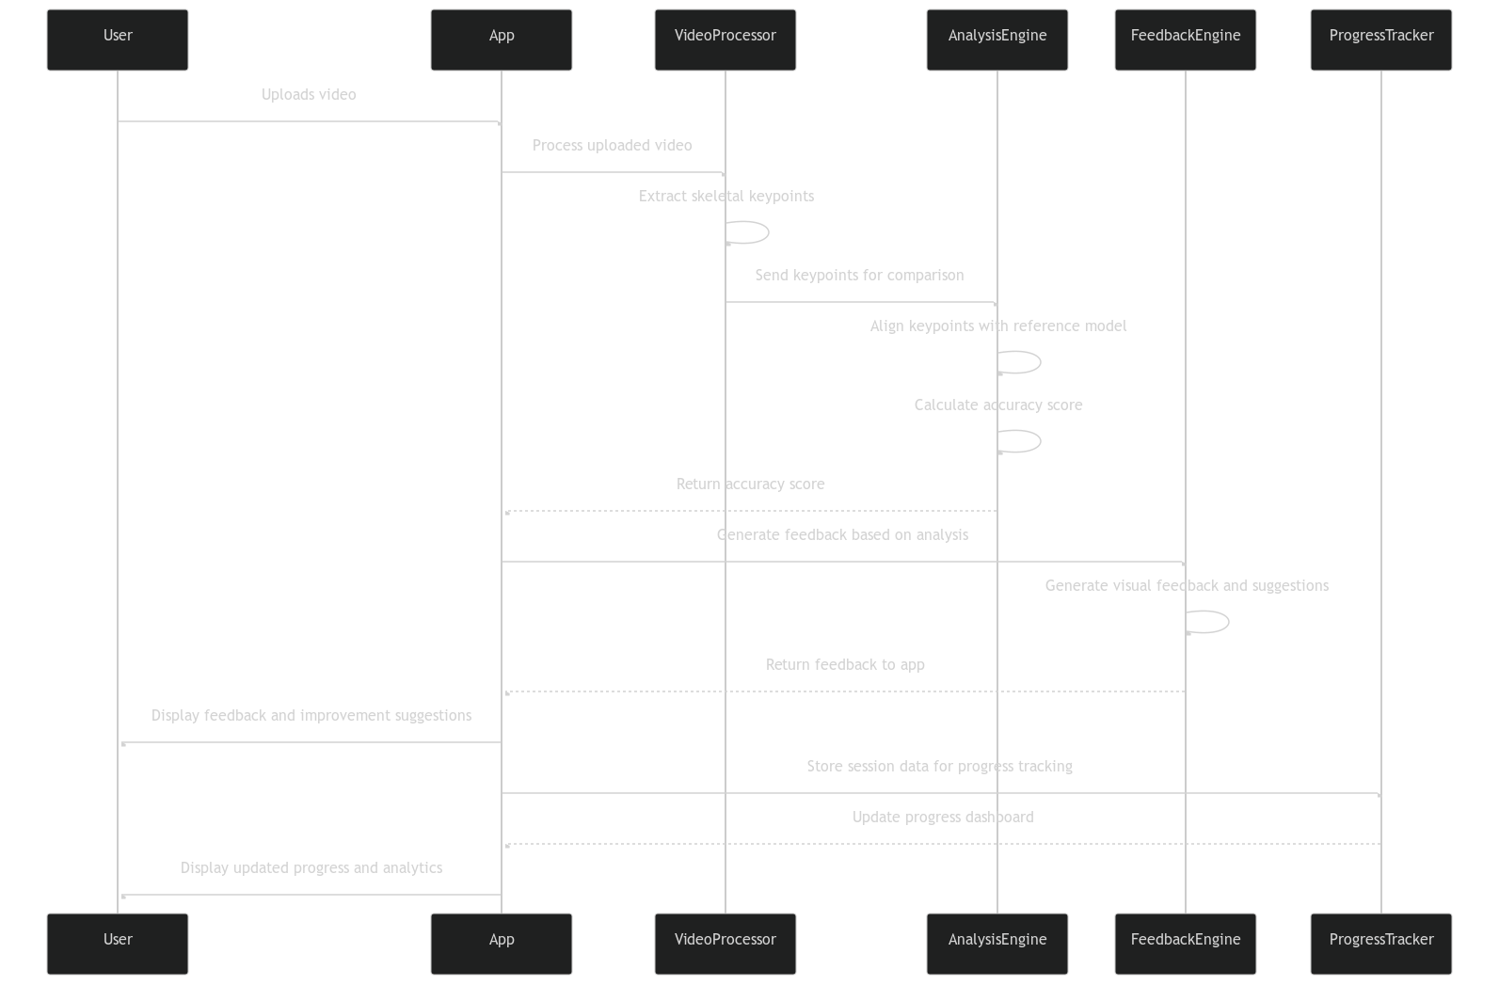
Sequence diagram

Slide 10
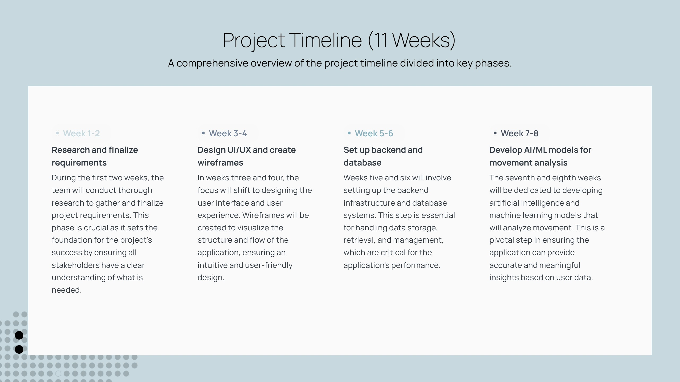
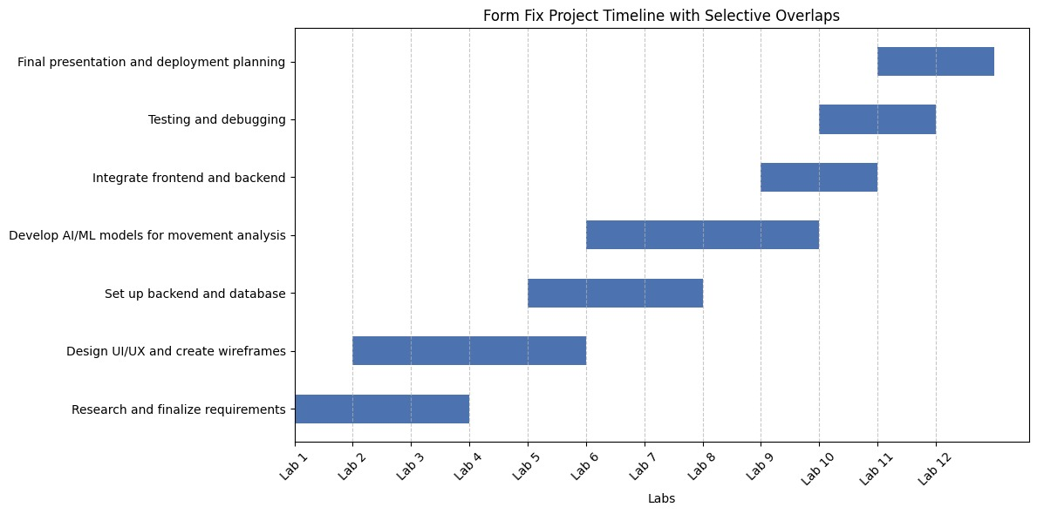

Slide 11
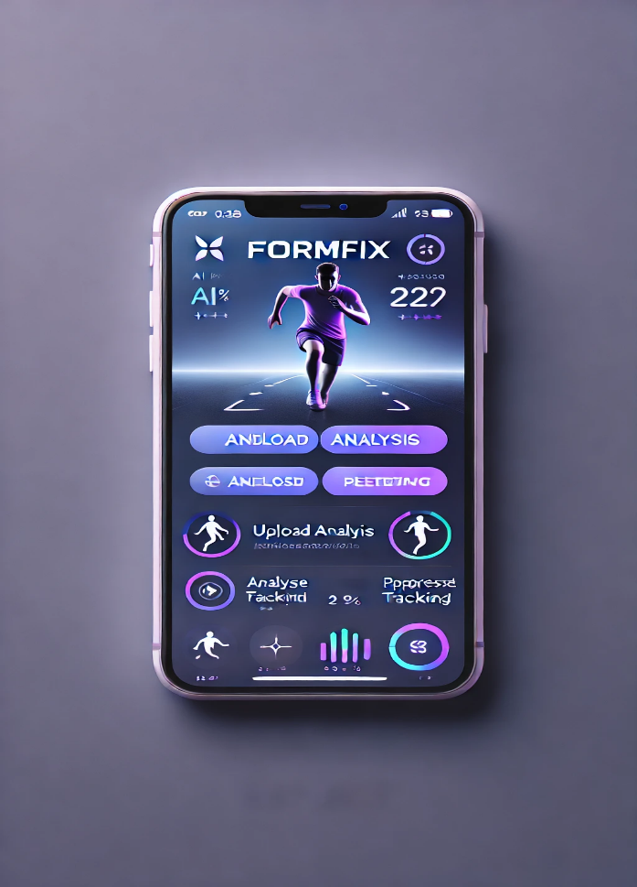
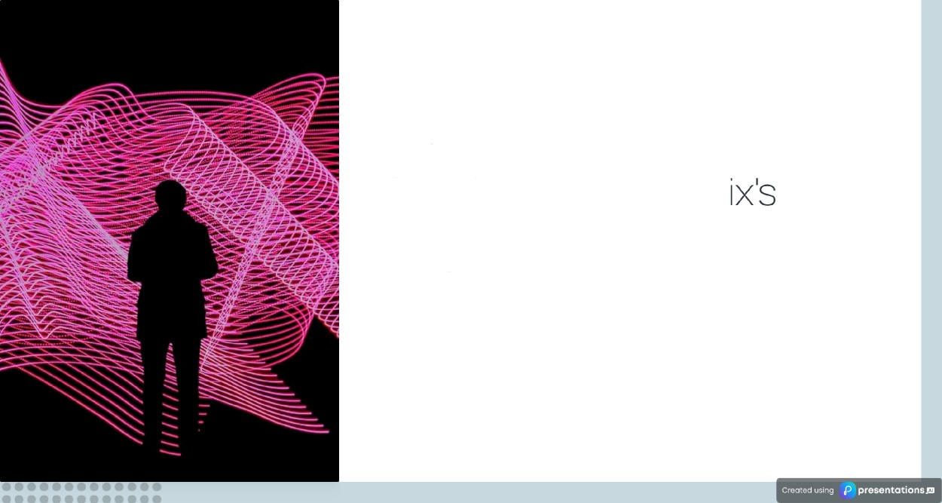
Conclusion on Formfix impact on physical performance
Revolutionizing Self-Assessment with AI and Machine Learning

